Slide 1
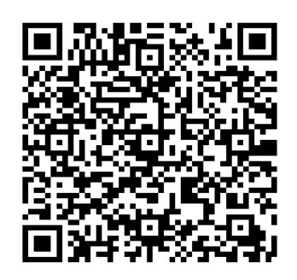
Mini Project-1 QR CODE GENERATOR Use Case diagram and Activity diagram
CHARAN RAJ 1602-20-737-009
GOURI MANASA 1602-20-737-014
SUHIDHAR 1602-20-737-048

Slide 2
Steps involved:
Enter details.
Encode details and Generate QR code.
Save generated QR code in the local folder as .png file.
Scan the generated QR code.
Decode the QR code and retrieve the details.
Display the details.

Slide 3
Use cases:
User/Student
Enter details
Scan the QR

Slide 4
Use case 1:
Name: Details
Actors: User
Description: Allow the user to enter details.
Precondition: None
Postcondition: QR code is generated for the corresponding details.
User | System
1)Enters the corresponding details and submit
 | 2)QR code is generated for the given details

Slide 5
Use case 2:
Name: Scan the code
Actors: Scanner
Description: Allows the scanner to scan the generated QR
Precondition: Use any app to scan
Postcondition: Scans the QR code which is generated and can save the QR.
User | System
1)Scans the generated QR code
 | 2)Displays the result which is encoded in the generated QR code. And saves the generated QR code in a local folder

Slide 6
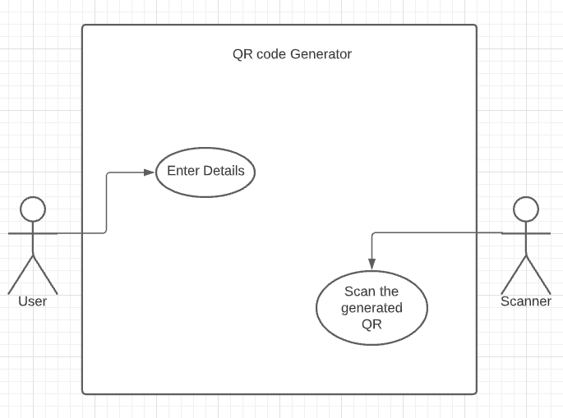
Use Case Diagram:

Slide 7
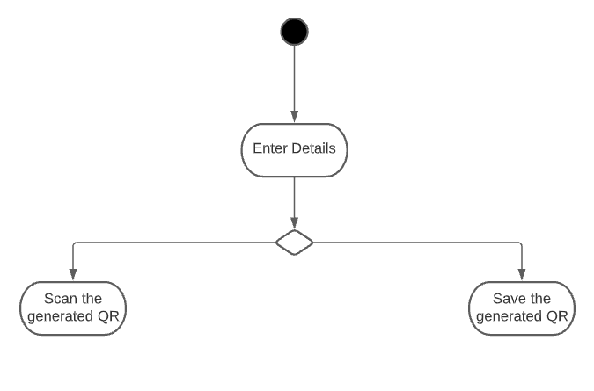
Activity Diagram:

Slide 8
Thank you

